Slide 1
Relational Model

Slide 2
Outline
Structure of Relational Databases
Database Schema
Keys
Schema Diagrams
Relational Query Languages
The Relational Algebra
Notes:
1

Slide 3
Relational Model Foundation
Relational Model of data is based on the concept of RELATION
A Relation is a Mathematical concept based on idea of SETS
The strength of the relational approach to data management comes from the formal foundation provided by the theory of relations
The model was first proposed by Dr. E.F. Codd of IBM in 1970

Slide 4
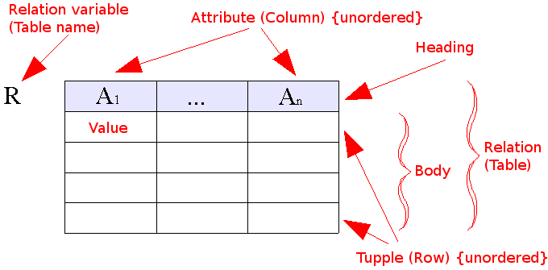
Relational Model (1970)
Data as set of tables
Having constraints and relationships
Oracle, DB2,Sybase

Slide 5
Some Terms
Informal Name
Table
Row or Record
Column or Field
No. of Rows
No. of Columns
Unique Identifier
Legal Values Set
Formal Name
Relation
Tuple
Attribute
Cardinality
Degree or Arity
Primary key
Domain

Slide 6
Relational Database: Definitions
Relational database: a set of relations
Relation: made up of 2 parts:
  Instance : a table, with rows and columns.
  #Rows = cardinality, #fields = degree / arity.
  Schema : specifies name of relation, plus name and type of each column.
    E.G. Students(sid: string, name: string, login: string, age: integer, gpa: real).
Can think of a relation as a set of rows or tuples (i.e., all rows are distinct).
Notes:
3

Slide 7
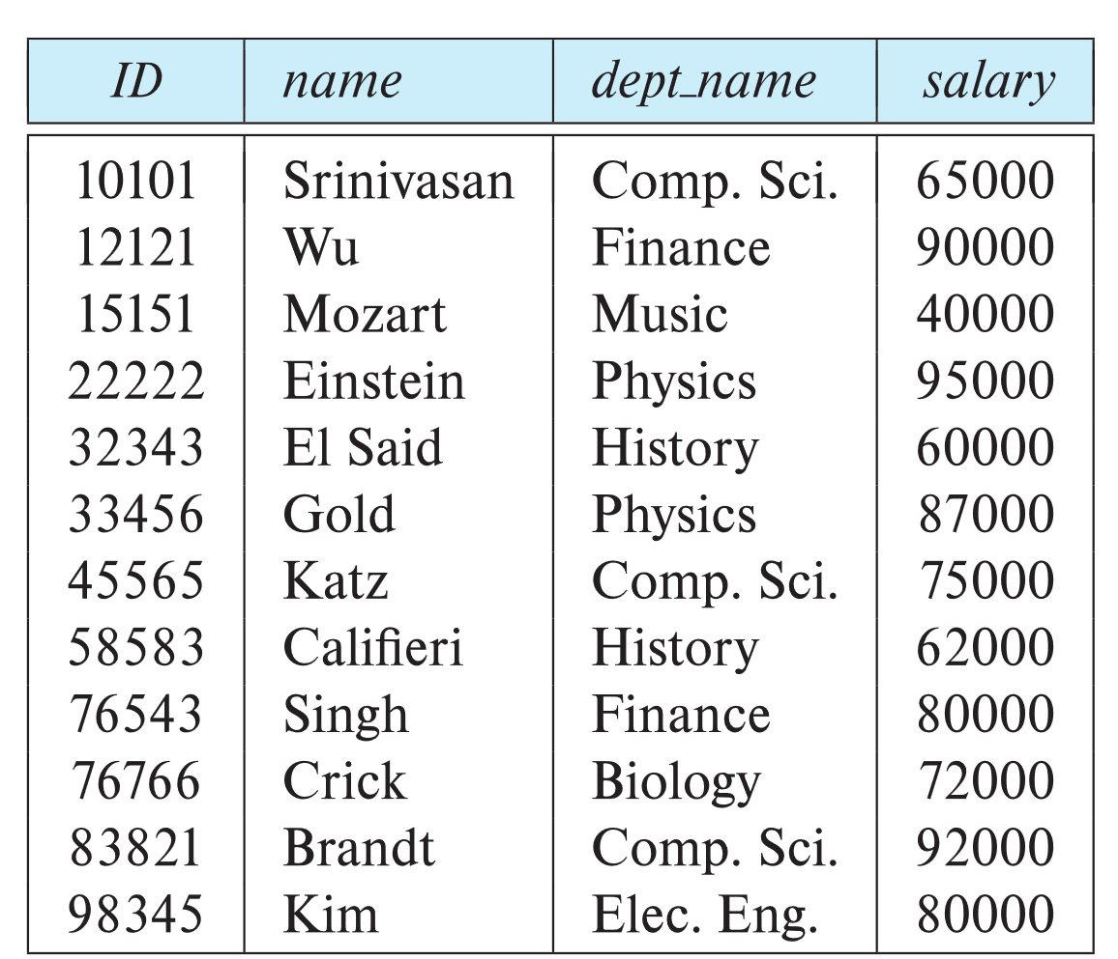
Example of a Instructor Relation
attributes
(or columns)
tuples
(or rows)

Slide 8
Relation Schema and Instance
A₁, A₂, …, A_{n} are attributes
R = (A₁, A₂, …, A_{n} ) is a relation schema
Example:
instructor = (ID, name, dept_name, salary)
A relation instance r defined over schema R is denoted by r (R).
The current values a relation are specified by a table
An element t of relation r is called a tuple and is represented by a row in a table
Notes:
1

Slide 9
Attributes
The set of allowed values for each attribute is called the domain of the attribute
Attribute values are (normally) required to be atomic; that is, indivisible
The special value null is a member of every domain. Indicated that the value is “unknown”
The null value causes complications in the definition of many operations

Slide 10
Null Values
Comparisons with null values return the special truth value null (unknown)
Three-valued logic using the truth value null:
  OR: (null OR true) = true
  (null OR false) = null
  (null OR null) = null
  AND: (true AND null) = null
  (false AND null) = false
  (null AND null) = null
  NOT: (NOT null) = null

Slide 11
Attributes
  An attribute is a characteristic
    Property, data element, field, attribute
    Ex: Student (name, IDNo, course credit)
  Domain
  Attributes can be
    Atomic (simple) vs. Composite
      Ex: Student ID , Student name
        Where student name may consists of (first, middle, last name)
    Single-valued vs. Multi-valued
      Ex. number of courses registered, names of registered courses
    Derived
      Ex: age of a student

Slide 12
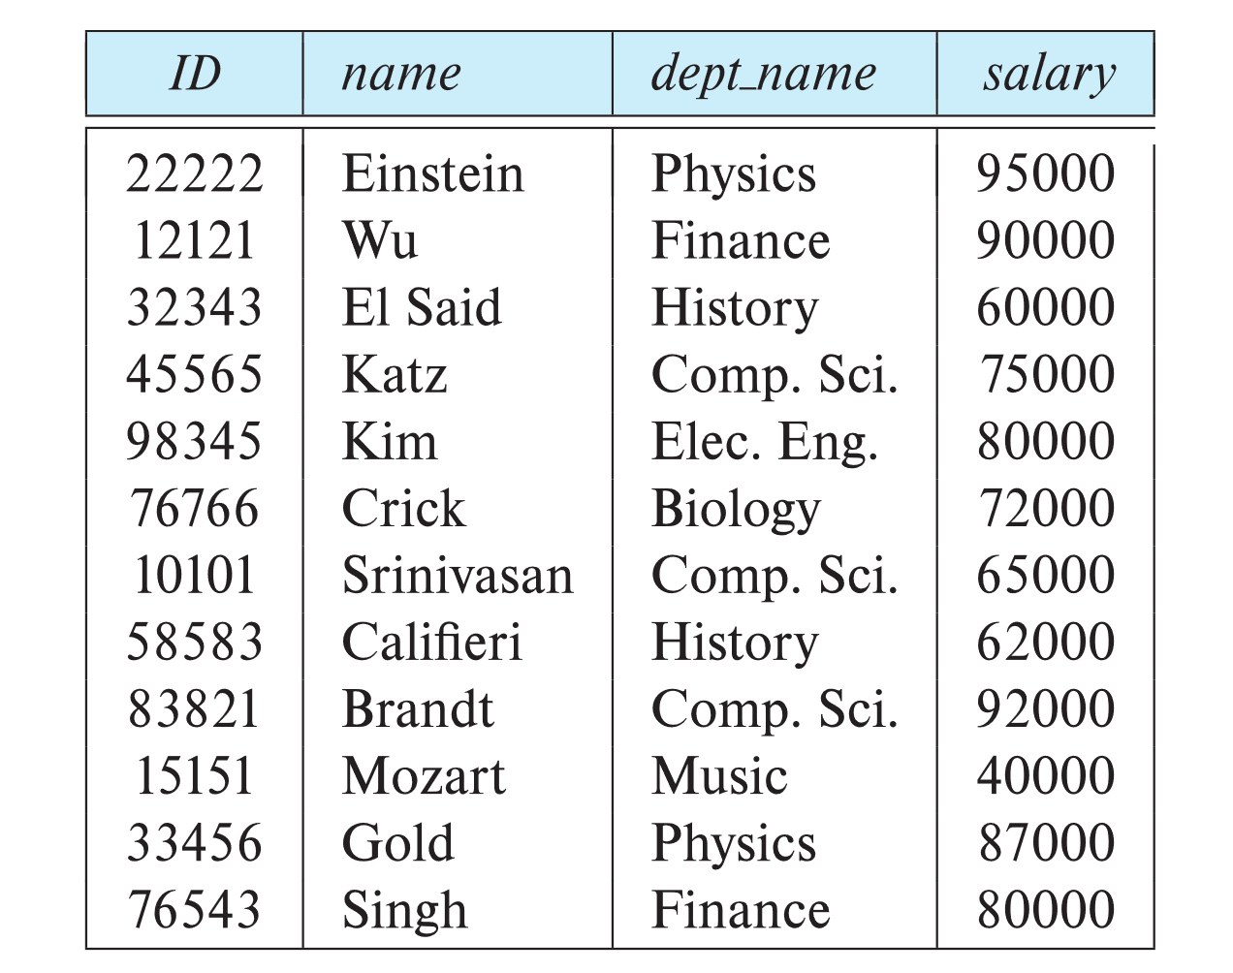
Relations are Unordered
Order of tuples is irrelevant (tuples may be stored in an arbitrary order)
Example: instructor relation with unordered tuples

Slide 13
Database Schema
Database schema -- is the logical structure of the database.
Database instance -- is a snapshot of the data in the database at a given instant in time.
Example:
  schema: instructor (ID, name, dept_name, salary)
  Instance:

Slide 14
Keys
Superkey (SK)
  Set of one or more attributes which taken collectively identifies uniquely an entity in a relation set
  Ex: Student ( student name, IDNo, CPI, program, address)
  Student relation set superkey can be (student name, IDNo)
  Superkey may contain extraneous attributes
  There can be more than one superkeys
Candidate Key (CK)
  A superkey for which no subset is a superkey
  Ex: IDNo is a Candidate Key as it is minimal and uniquely identifies a student from Student relation Set
  There can be more than one candidate keys

Slide 15
Keys
Primary Key (PK)
  Is a candidate key
  One of the candidate key is chosen by database designer as a primary key
Example
  Telephone Book( STD Code, Telephone number, Name, Address)
  Composite Key

Slide 16
Keys
Let K ⊆ R
K is a superkey of R if values for K are sufficient to identify a unique tuple of each possible relation r(R)
  Example: {ID} and {ID,name} are both superkeys of instructor.
Superkey K is a candidate key if K is minimal
Example: {ID} is a candidate key for Instructor
One of the candidate keys is selected to be the primary key.
  Which one?
Foreign key constraint: Value in one relation must appear in another
  Referencing relation
  Referenced relation
  Example: dept_name in instructor is a foreign key from instructor referencing department

Slide 17
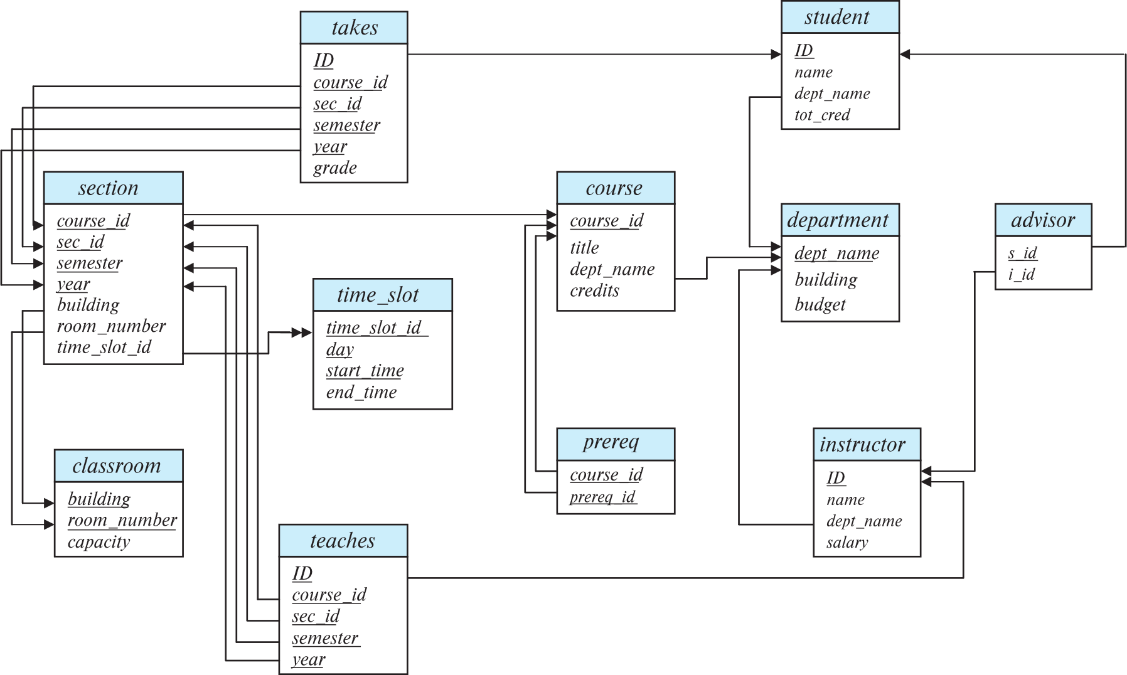
Schema Diagram for University Database

Slide 18
Schema of University Database
classroom(building, room number, capacity)
department(dept name, building, budget)
course(course id, title, dept name, credits)
instructor(ID, name, dept name, salary)
section(course id, sec id, semester, year, building, room number, time slot id)
teaches(ID, course id, sec id, semester, year)
student(ID, name, dept name, tot cred)
takes(ID, course id, sec id, semester, year, grade)
advisor(s ID, i ID)
time slot(time slot id, day, start time, end time)
Prereq (course id, prereq id)

Slide 19
Relational Query Languages
Procedural versus non-procedural, or declarative
“Pure” languages:
  Relational algebra
  Tuple relational calculus
  Domain relational calculus
The above 3 pure languages are equivalent in computing power
We will concentrate in this chapter on relational algebra
  Consists of 6 basic operations

